Slide 1






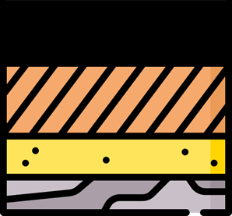


Main Windows
FlexPave 0.1
File Setting Help About
Weather
Traffic
Materials
Structure
Calculations
Report

Slide 2


Structure
FlexPave 0.1
File Home Setting Help About
+ Add Layer
Save Structure
Back
Layer | Material | Elastics Moulus [Mpa] | Poisson Modulus | Thickness [cm]
Layer 1 | Name 1 | 100 | 100 | 100
Layer 2 | Name 2 | 100 | 100 | 100
Subgrade | Name 3 | 100 | 100 | 100
LAYER 1
Thickness 1
LAYER 2
Thickness 2
SUGRADE

